Slide 1
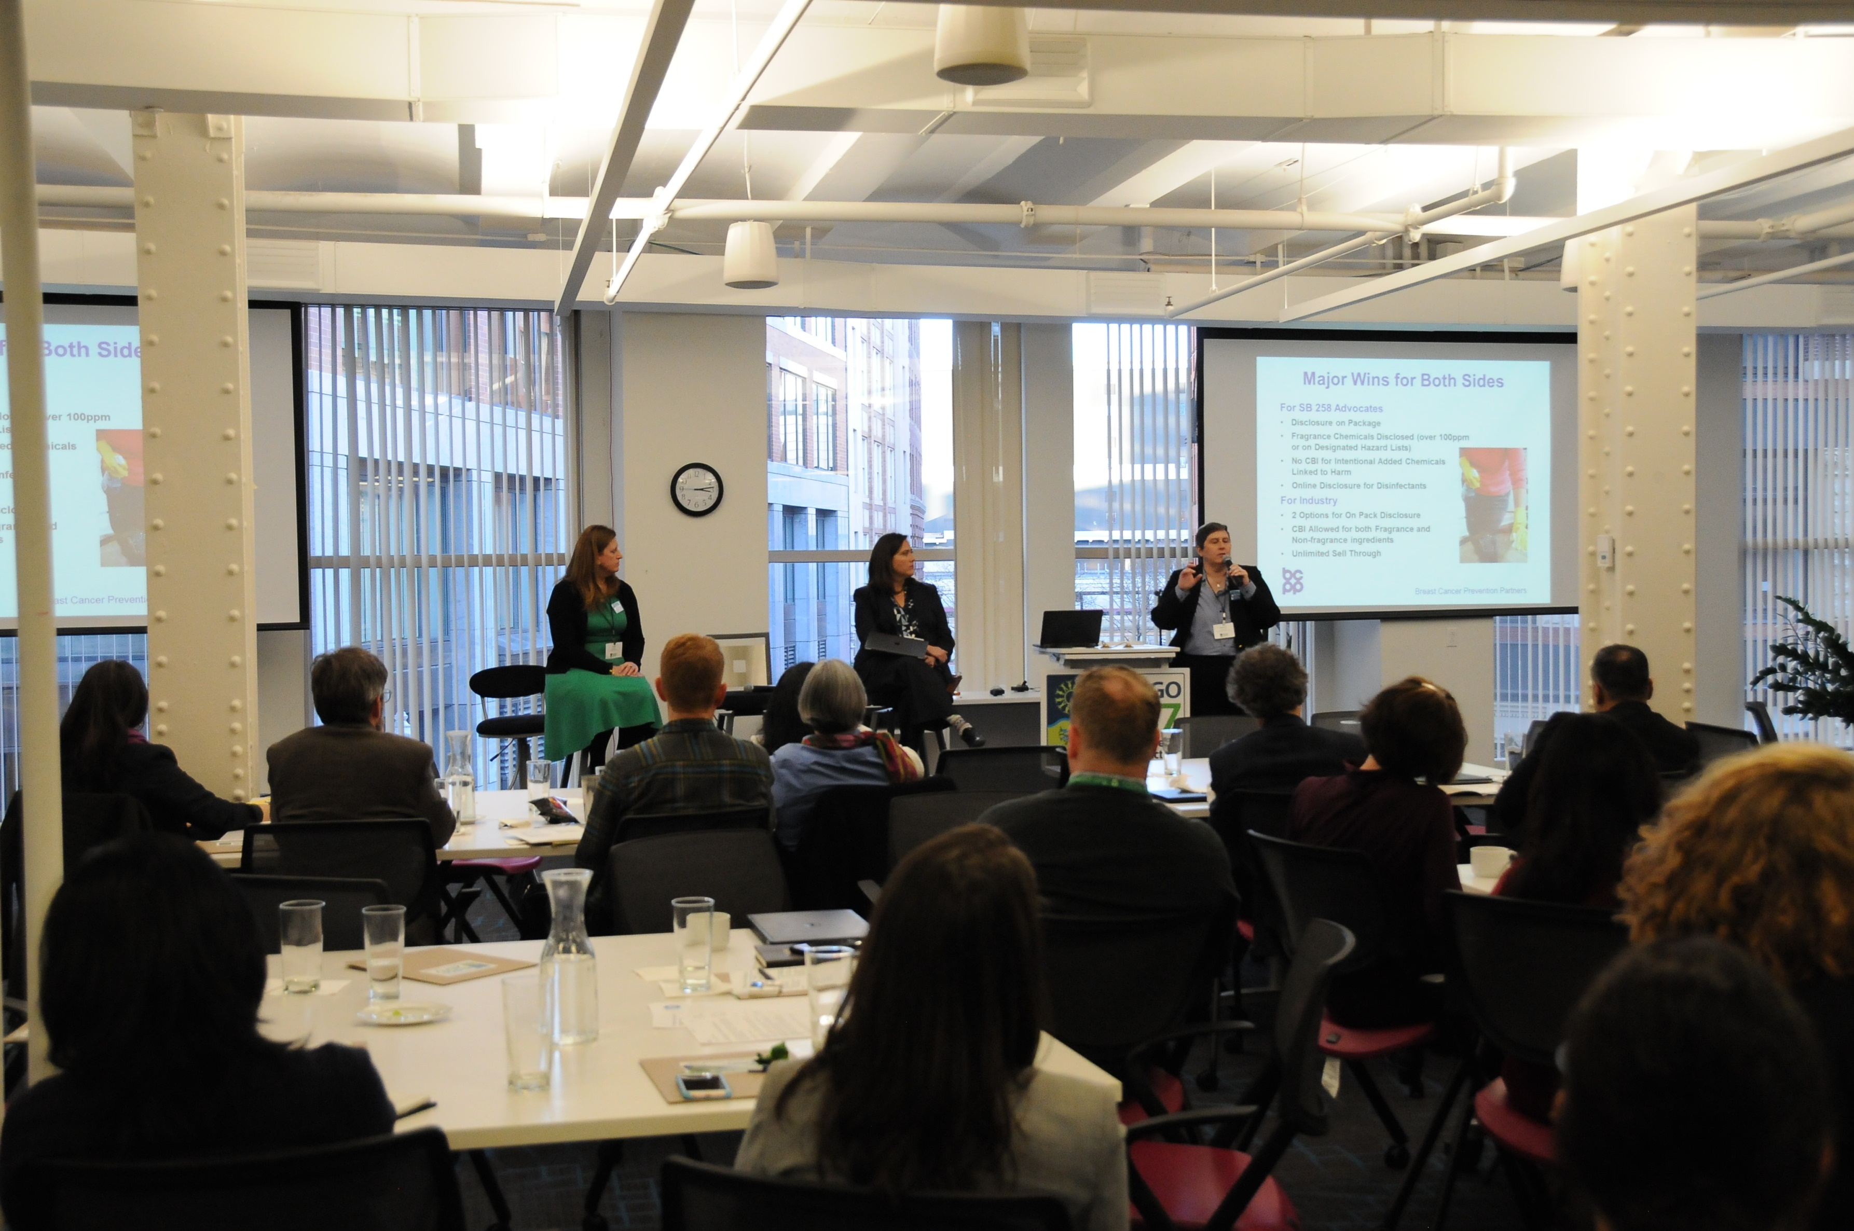


BizNGO 2020
15th Annual Meeting
It looks a little different this year but we’re so happy to have you!

Slide 2


Thank you to our sponsors!

Slide 3
BizNGO 2020
Session 2
Chemical Footprinting
December 8th 3:00-6:00 pm EST

Slide 4
Session 2
3:00 – 4:15 ET Session 2a: Best Practices in Chemicals Management Disclosure
4:15 - 4:45 ET Break
4:45 – 6:00 ET Session 2b: Lessons Learned in Measuring Chemical Footprints

Slide 5
Zoom Protocol
Mute yourself when not speaking
Raise hand to verbally ask a question
Chat questions & comments
Feel free to show your video :)
Enter participant ID if calling in
Rename yourself to include your organization

Slide 6
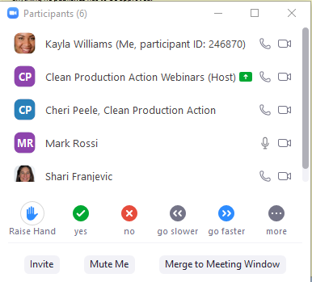
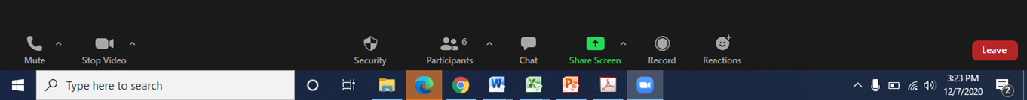
Raise Hand
Chat

Slide 7
Meeting Logistics
Presentations will be recorded
Breakouts, Q&A, & report backs will not be recorded
PPTs will be posted online
If something goes wrong contact
      Kayla 781.391.6743 x120
      Ellen 781.391.6743 x102

Slide 8

Chatham House Rule
Participants are free to use the information received, but neither the identity nor the affiliation of the speaker(s), nor that of any other participant, may be revealed; unless approved by the participant

Slide 9
BizNGO 2020
Session 2a
Best Practices in Chemicals Management Disclosure
December 8th 3:00-4:15 pm EST

Slide 10
Session 2a Desired Outcomes
Participants understand for chemicals management:
What investors want disclosed and why
Value proposition for disclosure
Leadership practices

Slide 11
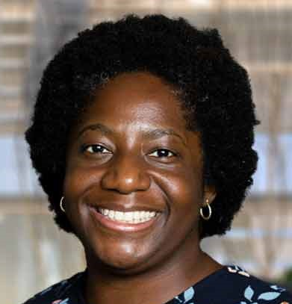
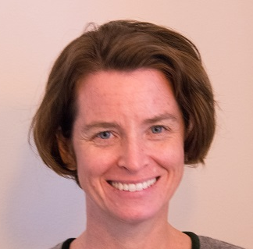
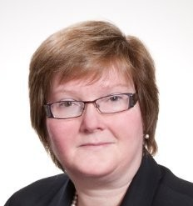
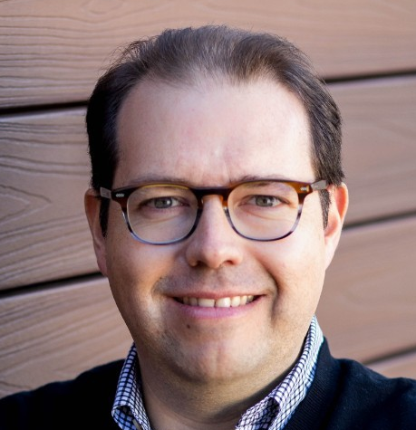
Speakers
Facilitator:
Boma Brown-West
Director of Consumer Health EDF+Business
Cheri Peele
Program Manager
Chemical Footprint Project
Clean Production Action
Lauren Compere
Managing Director
Boston Common Asset Management
Roberto Bertin
Senior Manager
Sustainability Strategic Initiatives
Walmart

Slide 12
Session 2a Agenda
Introduction: Boma Brown-West
Chemical Footprint Project 2020 Annual Report Preview: Cheri Peele
Reflections on Chemicals Management Disclosure: Lauren Compere & Roberto Bertin
Facilitated Conversation, Q&A
Small Groups
Report back
Break: 4:15-4:45 pm EST

Slide 13

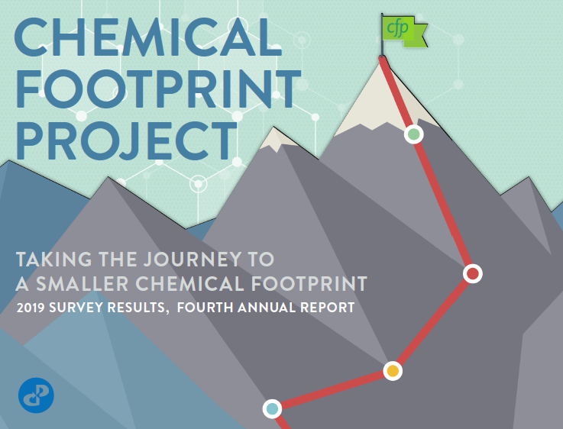
Preview of the 2020 Annual Report
December 8, 2020

Slide 14
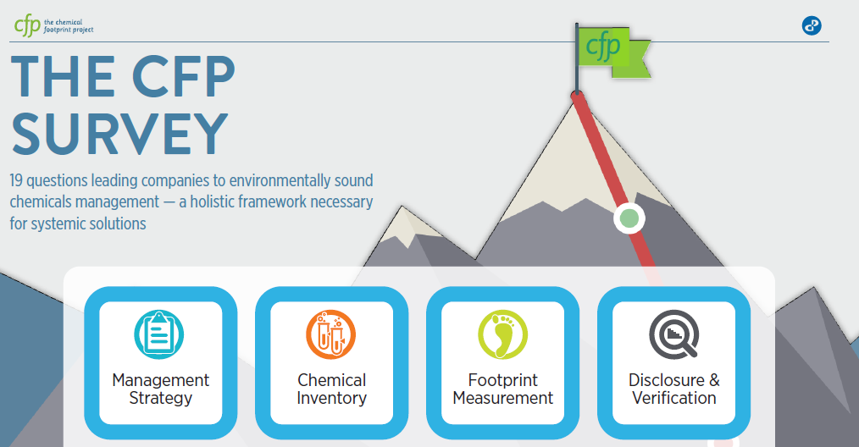

5th
^{annual}

Slide 15

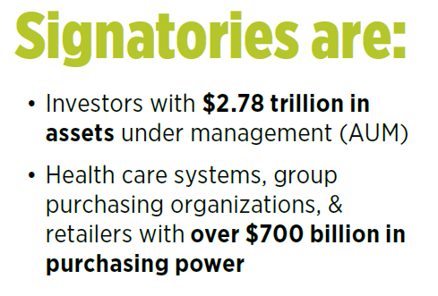
Investors include …
Health Care & Retail include …
CVS Health, Rite Aid, Staples, Target & Walmart
Calvert Research & Management
Bank J Safra Sarasin
BNP Paribas Investment Partners
Boston Common Asset Management
Impax Asset Management
Trillium Asset Management
Legal & General Investment Management
Rhode Island Treasury
The Sustainability Group of Loring, Wolcott & Coolidge
Dignity Health, Kaiser Permanente, & Vizient
Notes:
Over 60 signatories, 44 investors, 13 health care, 3 retailers

Slide 16
Participants in 2020 Survey
33 companies
Sectors:
Apparel / Textiles
Building / Furnishings
Cleaning / Personal Care
Medical devices/supplies
Technology
Retail
Toys
Disclosure:
15 disclosed scores
12 disclosed responses

Slide 17

Participant Scores
Compliance
Best practice
Average score: 56

Slide 18
Average scores, new vs. returning participants
(% of total possible points)

Slide 19
Participant Scores: Frontrunners
Frontrunners
Compliance
Best practice

Slide 20
Frontrunners: Distinguishing characteristics
Senior level accountability (M4)
Chemical footprint calculation (F2, F3)

Slide 21
Frontrunners: Distinguishing characteristics
Preference for safer alternatives (M1, F5)
Likelihood to disclose (I2, F2)

Slide 22
CFP 2020 Annual Report
Will be released December 15, 2020
Available at chemicalfootprint.org
cheri@cleanproduction.org

Slide 23
Poll
What do you think is the most important information to disclose publicly about chemicals management?
Chemicals policy and hazard reduction goals
RSL/MRSL
Steps taken with suppliers to reduce hazard
Safer alternatives definition & goals
Footprint reduction progress
Chemical ingredients in products

Slide 24
Small Groups
For businesses:
What groups, if any, have requested information about your chemicals management? How have you responded? If you have not, what would prompt your organization to do so?
For NGOs/investors/other:
Have you requested information from businesses about their chemicals management? Have those requests been answered? What additional information do you seek?

Slide 25
Report back

Slide 26
Break
4:15 -4:45 ET
Mute & go off video OR
Leave the meeting and call back in

Slide 27
BizNGO 2020
Session 2b
Chemical Footprinting
December 8th 4:45-6:00 pm EST

Slide 28
Session 2b Desired Outcomes
Participants understand:
The value of calculating a corporate chemical footprint
How a chemical footprint can be determined for different types of products
What companies have learned over time from calculating their corporate chemical footprints

Slide 29

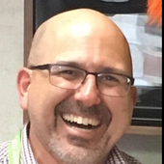
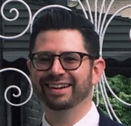

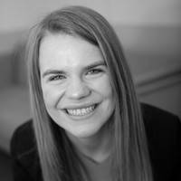
Speakers
Facilitator:
Sally Edwards
Lowell Center for Sustainable Production
University of Massachusetts Lowell
Co-founder of CFP
Antonio Quiñones-Rivera
Senior Manager
Product Safety & Sustainability
GOJO
Ross Bergman
Senior Sustainability Engineer
Humanscale
Jennifer Reece
Program Manager
Materials Leadership
HP
Evelyn Ritter
Director of Customer Success
Toxnot

Slide 30
Session 2a Agenda
Introduction: Sally Edwards
Brief Presentations: Panelists
Facilitated Conversation
Audience Q&A

Slide 31
5th
^{annual}

Slide 32
Poll
In your opinion, what is the biggest benefit of calculating a corporate chemical footprint?
Tracking overall chemical risk
Identifying and prioritizing opportunities for reduction in use of chemicals of high concern
Improved communication with stakeholders
Helps to reduce use of regrettable substitutes

Slide 33
At end of session: please note in Chat Box
What is your key takeaway from this session?

Slide 34
Day 2: December 9
Session 3, 11:00 – 2:00 ET:
Taking on the challenges to chemical ingredient disclosure
Session 4: 3:00 – 6:00 ET:
Getting Ahead of Chemical Classes

Slide 35
Thank you for joining! Today’s presentations and slides will be made available at www.bizngo.org.
Please fill out the evaluation form for this session!

